Slide 1

Wireless Networking
Ambuj Varshney
Assistant Professor, National University of Singapore
Wireless, Embedded Intelligence, Sensing, and Emerging Technologies Group
ambujv@nus.edu.sg
Notes:
++ Thank you for inviting me to give this talk
++ In this talk, I will present a pathway that can enable us to make wireless embedded systems ubiquitous. I will describe my previous research efforts that tackle the critical challenges that limit the growth of wireless embedded systems. These are related to the growing energy asymmetry that exists between sensing, computation and communication blocks on these platforms.
++ Finally, I will conclude my talk by covering the research agenda that I would like to work on as a faculty member.

Slide 2
Lecture 2: Signal Propagation, Device Basics, and Operating System
Notes:
++ Over the past few years, I have designed several backscatter and beyond backscatter systems that precisely overcome these critical challenges that have limited the widespread deployment of backscatter on IoT devices.
++ The research vision that I have pursued and would like to pursue as a faculty member is to enable a massive deployment of IoT devices by bridging the energy asymmetry between sensing, computation and communication blocks by designing novel platforms and communication mechanisms. I am going to describe some of my research contributions next.

Slide 3
Administration and Course Logistics
Notes:
++ Over the past few years, I have designed several backscatter and beyond backscatter systems that precisely overcome these critical challenges that have limited the widespread deployment of backscatter on IoT devices.
++ The research vision that I have pursued and would like to pursue as a faculty member is to enable a massive deployment of IoT devices by bridging the energy asymmetry between sensing, computation and communication blocks by designing novel platforms and communication mechanisms. I am going to describe some of my research contributions next.

Slide 4
General course information
Course code: 4222/5222, Tuesday – 6:30pm – 8:30pm
Office hours: COM3 - #2 – 25, Friday : 4 – 6 pm (by appointment)
Please send me an email to reserve slot
Notes:
++ We may all have heard of the term Internet of Things. So how are these wireless embedded systems related to the Internet of Things: Today, IoT includes a broad class of devices, including powerful platforms such as smartphones. However, it also includes more resource-constrained devices and what we call Wireless Embedded Systems, and in fact, I consider it to be one of the essential parts of the IoT ecosystem.
++ These are platforms equipped with a radio transceiver, sensor, microcontroller, and some form of energy storage. These platforms also often form a network, and sensor network as it is called has been an active area of research for the past two decades.
++ The research community has also developed wireless embedded platforms which we may know about, and these include: CMUCAM, which is an image sensor platform developed at Carnegie Mellon University, or Permamote is long life sensor platform from the lab I am associated with at UC Berkeley or Lorea which is a long-range backscatter platform that I had developed as part of my doctoral dissertation at Uppsala University. All of these are an example of Wireless Embedded Systems.

Slide 5
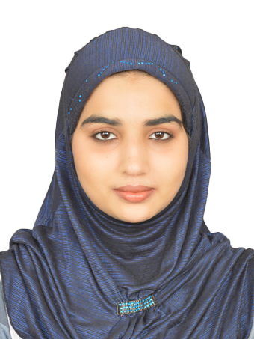
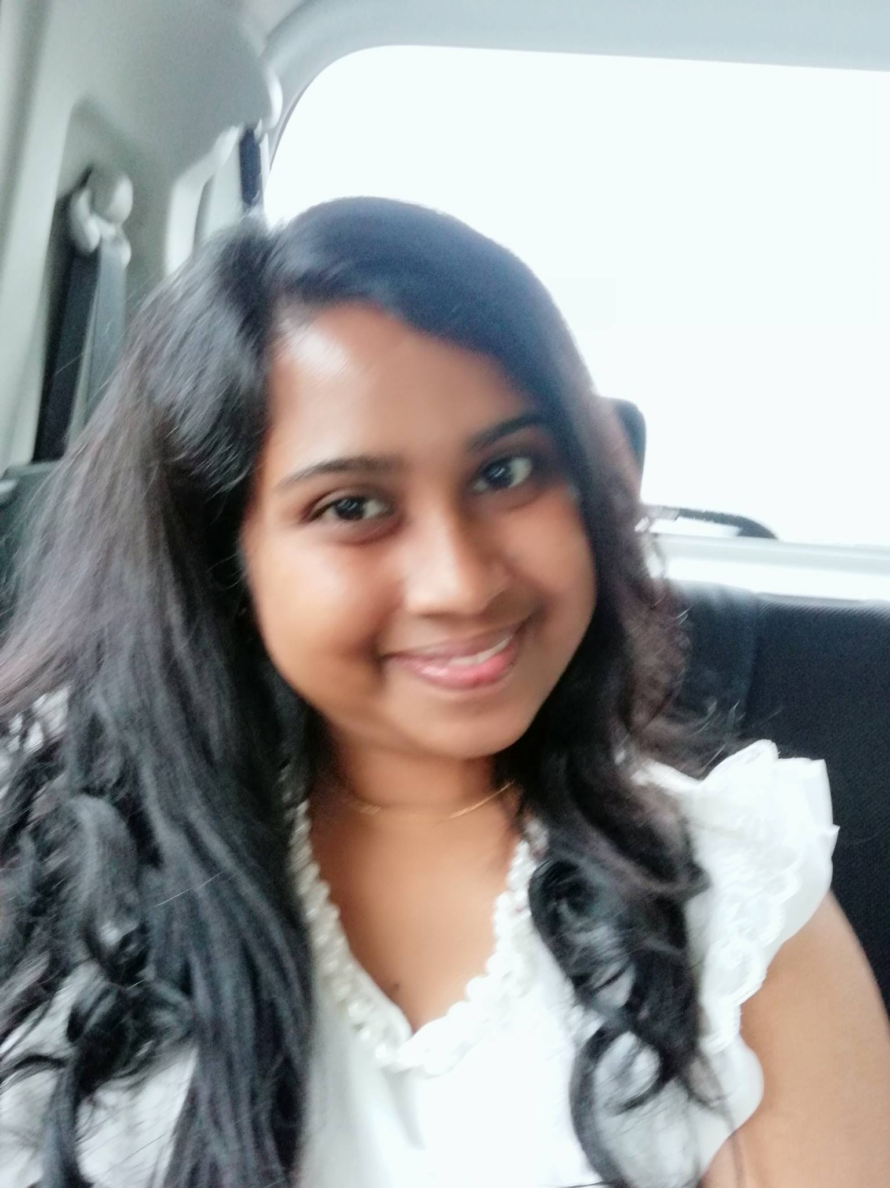
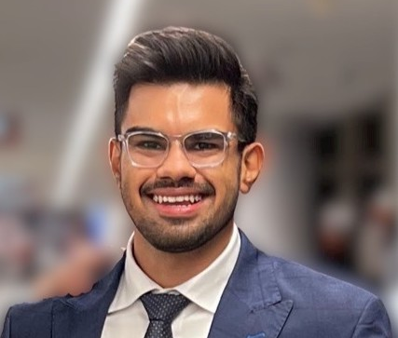
Teaching assistants
Tutorials: Starting Next Week! Please register tutorial slots
Tutorial for next week, released on Saturday
We have amazing teaching assistants to help with the course:
Malaika Afra Taj (PhD Student, SoC)
Kanav Sabharwal (PhD Student, SoC)
Ayanga Kalupahana (PhD Student SoC)
Notes:
++ We may all have heard of the term Internet of Things. So how are these wireless embedded systems related to the Internet of Things: Today, IoT includes a broad class of devices, including powerful platforms such as smartphones. However, it also includes more resource-constrained devices and what we call Wireless Embedded Systems, and in fact, I consider it to be one of the essential parts of the IoT ecosystem.
++ These are platforms equipped with a radio transceiver, sensor, microcontroller, and some form of energy storage. These platforms also often form a network, and sensor network as it is called has been an active area of research for the past two decades.
++ The research community has also developed wireless embedded platforms which we may know about, and these include: CMUCAM, which is an image sensor platform developed at Carnegie Mellon University, or Permamote is long life sensor platform from the lab I am associated with at UC Berkeley or Lorea which is a long-range backscatter platform that I had developed as part of my doctoral dissertation at Uppsala University. All of these are an example of Wireless Embedded Systems.

Slide 6
Course homepage and webcast of lectures
Course homepage and other information can be found on following links:
Canvas (updated less frequently)
(Frequent updates) Link: https://weiserlab.github.io/ambuj/cs4222
We also have a slack page! If you are not added, please send me email
Video. Important parts of lecture 1 uploaded to YouTube (end of this week)
Would upload each lecture video: 1-2 weeks after lecture date
Notes:
++ We may all have heard of the term Internet of Things. So how are these wireless embedded systems related to the Internet of Things: Today, IoT includes a broad class of devices, including powerful platforms such as smartphones. However, it also includes more resource-constrained devices and what we call Wireless Embedded Systems, and in fact, I consider it to be one of the essential parts of the IoT ecosystem.
++ These are platforms equipped with a radio transceiver, sensor, microcontroller, and some form of energy storage. These platforms also often form a network, and sensor network as it is called has been an active area of research for the past two decades.
++ The research community has also developed wireless embedded platforms which we may know about, and these include: CMUCAM, which is an image sensor platform developed at Carnegie Mellon University, or Permamote is long life sensor platform from the lab I am associated with at UC Berkeley or Lorea which is a long-range backscatter platform that I had developed as part of my doctoral dissertation at Uppsala University. All of these are an example of Wireless Embedded Systems.

Slide 7
Evaluation criteria for CS4222/5222
Continuous Assignments (70%)
programming assignments + projects TBA
2 individual programming assignments TBA
Groups of 2 to 4 members
2 group programming assignments (TBA)
1 group project (TBA)
Written Assignment 10%
Tutorial 5%
Final Assessment, open book (30%)

Slide 8
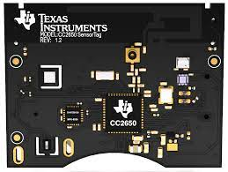
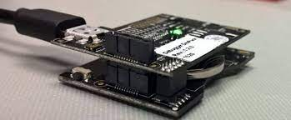
Programming Assignments (Individual)
Programming
Week 2 (this week): Collect device (SensorTag + debugging board)
Week 3/4: Assignment 1 (3%): installation, “Hello World” program (Released Saturday)
Week 5: Assignment 2 (7%): Timer and sensors (Release: TBA)
Written Assignment
Week 11 (10%): Written Assignment
Ms. Lim Chew Eng (limce limce@comp.nus.edu.sg)
Venue: Datacom Lab (COM1#B1-02)
Issue device to students on:
Date: 19 Jan (Thurs)
Time : 2pm to 4.30pm

Slide 9
ChatGPT and Prompts
Would provide prompts for OpenAI ChatGPT
Early technology, many times gives wrong answer. Be careful!
At this stage only a supplement to other resources
Demonstration of ChatGPT!

Slide 10
Review (last lecture) Wireless Basics
Notes:
++ Over the past few years, I have designed several backscatter and beyond backscatter systems that precisely overcome these critical challenges that have limited the widespread deployment of backscatter on IoT devices.
++ The research vision that I have pursued and would like to pursue as a faculty member is to enable a massive deployment of IoT devices by bridging the energy asymmetry between sensing, computation and communication blocks by designing novel platforms and communication mechanisms. I am going to describe some of my research contributions next.

Slide 11
What are wireless radios?
Radios are electronic devices that enables wireless transmission of signals
Electromagnetic signal is modulated and radiated out of the antenna
Wireless transmissions are then received by a receiver radio device
Antenna
Radio frequency signal
Radio transmitter
Radio receiver
Notes:
First, we look at the computational elements, and these consist of a microcontroller or an FPGA. Today, we find that these computational elements consume at least one order of magnitude higher power consumption when compared to the commonly used sensors.
However, we also find that microcontrollers are increasingly becoming energy efficient. We investigate a typical microcontroller that has been used in sensor platforms over the past two decades. We find that energy efficiency has improved by almost two orders of magnitude. Some of the present-generation microcontrollers, such as Ambiq Apollo4 consume just 3 uA/MHz than 330 uA for MSP430 used on platforms such as TelOS B.
If the trend continues, we can expect the microcontrollers to catch up with the sensors and become energy-efficient. This significant improvement is that the digital components are increasing becoming efficient as they follow moore’s law.

Slide 12
We need to understand several terms and concepts
What are electromagnetic signals?
How are these electromagnetic signals modulated?
How are they radiated from the transmitter to receiver?
How do these signals propagate? How far can we receive these signals?
What are different wireless standards ?
Antenna
Radio frequency signal
Radio transmitter
Radio receiver
Notes:
First, we look at the computational elements, and these consist of a microcontroller or an FPGA. Today, we find that these computational elements consume at least one order of magnitude higher power consumption when compared to the commonly used sensors.
However, we also find that microcontrollers are increasingly becoming energy efficient. We investigate a typical microcontroller that has been used in sensor platforms over the past two decades. We find that energy efficiency has improved by almost two orders of magnitude. Some of the present-generation microcontrollers, such as Ambiq Apollo4 consume just 3 uA/MHz than 330 uA for MSP430 used on platforms such as TelOS B.
If the trend continues, we can expect the microcontrollers to catch up with the sensors and become energy-efficient. This significant improvement is that the digital components are increasing becoming efficient as they follow moore’s law.

Slide 13
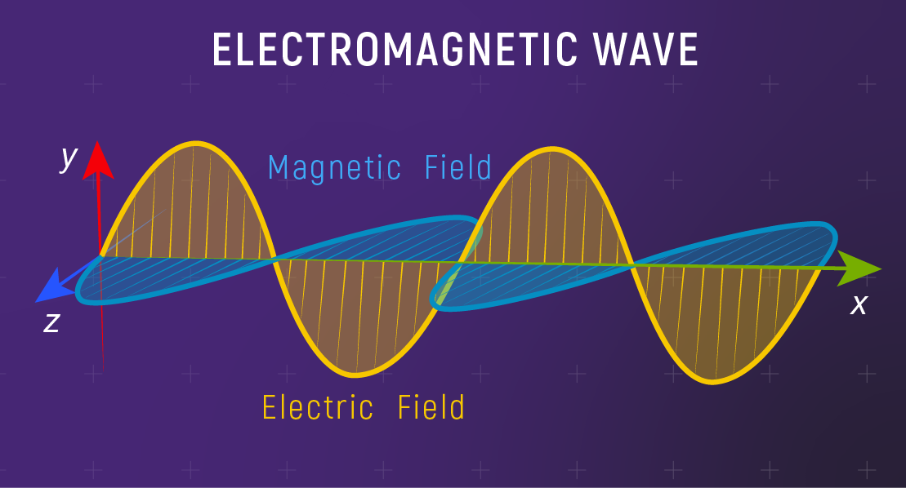
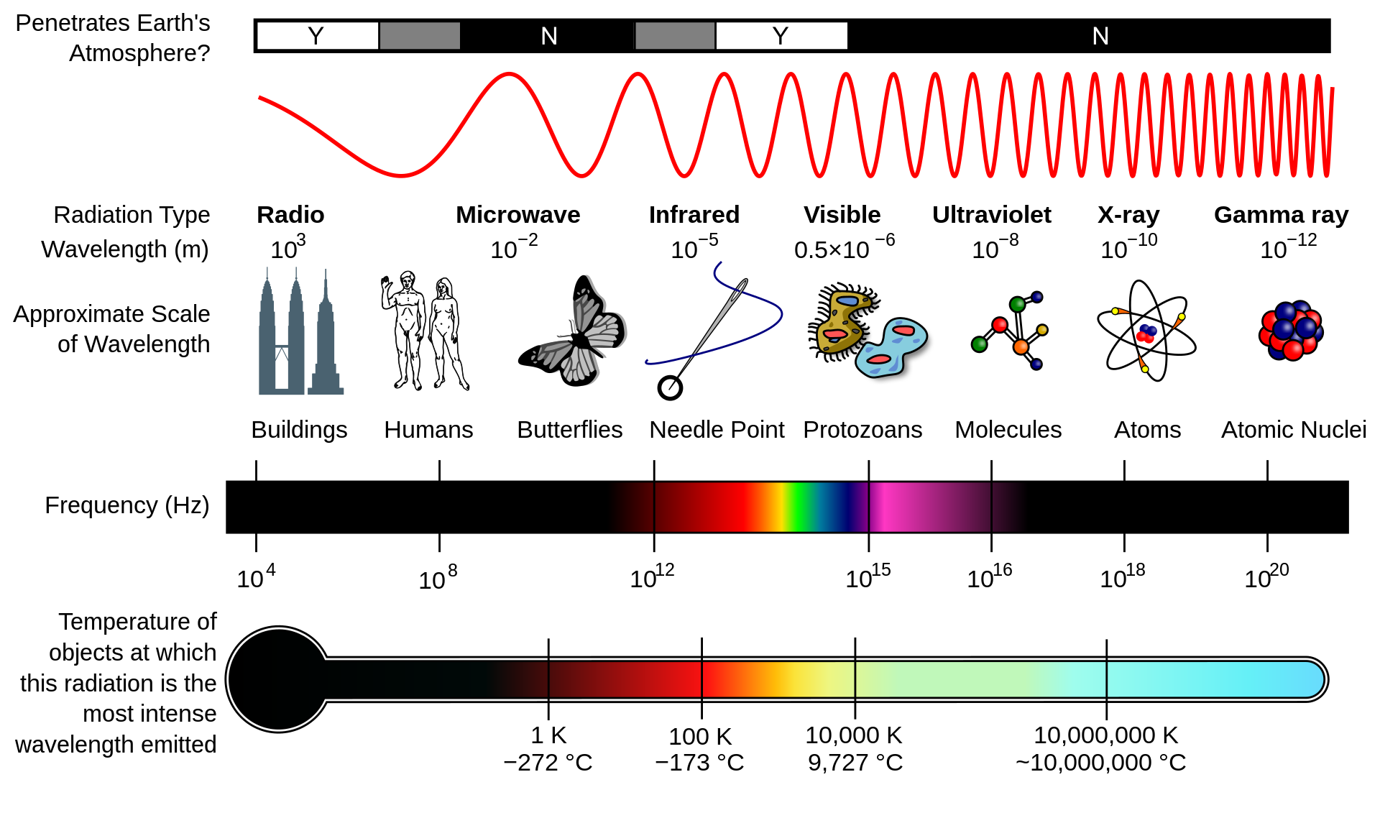
Electromagnetic waves and spectrum
Electromagnetic waves are synchronized oscillations of electric and magnetic field. There is a periodic change of electric and magnetic field
How often this periodic change occurs dictates the property of EM waves
Notes:
First, we look at the computational elements, and these consist of a microcontroller or an FPGA. Today, we find that these computational elements consume at least one order of magnitude higher power consumption when compared to the commonly used sensors.
However, we also find that microcontrollers are increasingly becoming energy efficient. We investigate a typical microcontroller that has been used in sensor platforms over the past two decades. We find that energy efficiency has improved by almost two orders of magnitude. Some of the present-generation microcontrollers, such as Ambiq Apollo4 consume just 3 uA/MHz than 330 uA for MSP430 used on platforms such as TelOS B.
If the trend continues, we can expect the microcontrollers to catch up with the sensors and become energy-efficient. This significant improvement is that the digital components are increasing becoming efficient as they follow moore’s law.

Slide 14
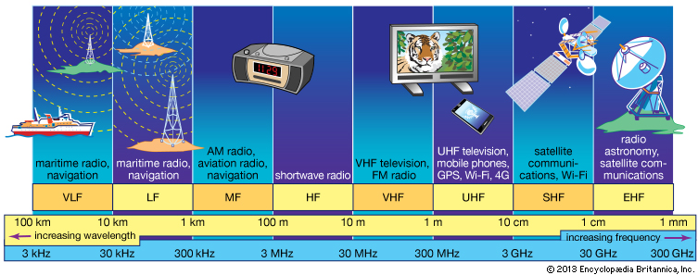
Radio waves are most important part of electromagnetic spectrum
Most (if not all) modern communication relies on radio waves
Frequency range of radio waves: 30 Hz to 300 GHz
Radio waves has the longest wavelength among EM
Notes:
First, we look at the computational elements, and these consist of a microcontroller or an FPGA. Today, we find that these computational elements consume at least one order of magnitude higher power consumption when compared to the commonly used sensors.
However, we also find that microcontrollers are increasingly becoming energy efficient. We investigate a typical microcontroller that has been used in sensor platforms over the past two decades. We find that energy efficiency has improved by almost two orders of magnitude. Some of the present-generation microcontrollers, such as Ambiq Apollo4 consume just 3 uA/MHz than 330 uA for MSP430 used on platforms such as TelOS B.
If the trend continues, we can expect the microcontrollers to catch up with the sensors and become energy-efficient. This significant improvement is that the digital components are increasing becoming efficient as they follow moore’s law.

Slide 15
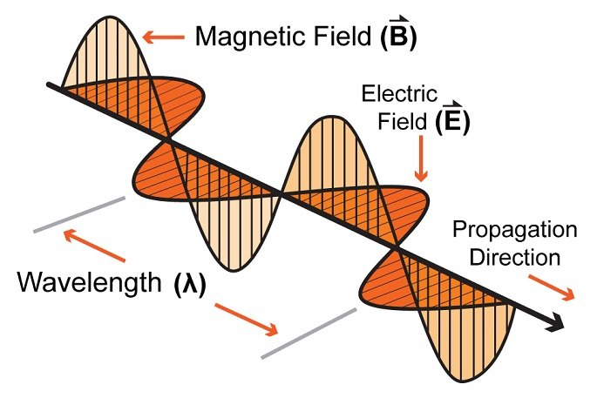
Characterization of radio waves
Signal strength
The amount of energy transmitted/received
Signal frequency and bandwidth
Which “channel” the signal is sent on
Signal modulation
How data is encoded in the signal
Notes:
First, we look at the computational elements, and these consist of a microcontroller or an FPGA. Today, we find that these computational elements consume at least one order of magnitude higher power consumption when compared to the commonly used sensors.
However, we also find that microcontrollers are increasingly becoming energy efficient. We investigate a typical microcontroller that has been used in sensor platforms over the past two decades. We find that energy efficiency has improved by almost two orders of magnitude. Some of the present-generation microcontrollers, such as Ambiq Apollo4 consume just 3 uA/MHz than 330 uA for MSP430 used on platforms such as TelOS B.
If the trend continues, we can expect the microcontrollers to catch up with the sensors and become energy-efficient. This significant improvement is that the digital components are increasing becoming efficient as they follow moore’s law.

Slide 16
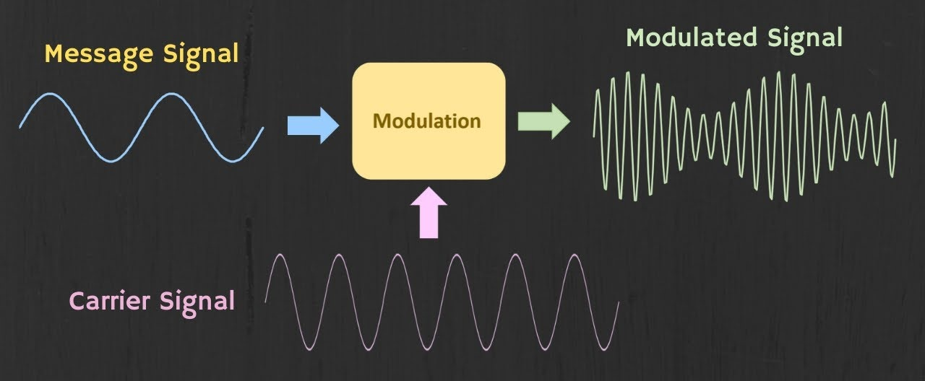
How are radio waves modulated with information
Encoding information “baseband" in an analog “carrier” signal
Baseband signal often much lower frequency than carrier
Carrier signal defines the frequency/part of electromagnetic spectrum
Notes:
First, we look at the computational elements, and these consist of a microcontroller or an FPGA. Today, we find that these computational elements consume at least one order of magnitude higher power consumption when compared to the commonly used sensors.
However, we also find that microcontrollers are increasingly becoming energy efficient. We investigate a typical microcontroller that has been used in sensor platforms over the past two decades. We find that energy efficiency has improved by almost two orders of magnitude. Some of the present-generation microcontrollers, such as Ambiq Apollo4 consume just 3 uA/MHz than 330 uA for MSP430 used on platforms such as TelOS B.
If the trend continues, we can expect the microcontrollers to catch up with the sensors and become energy-efficient. This significant improvement is that the digital components are increasing becoming efficient as they follow moore’s law.

Slide 17
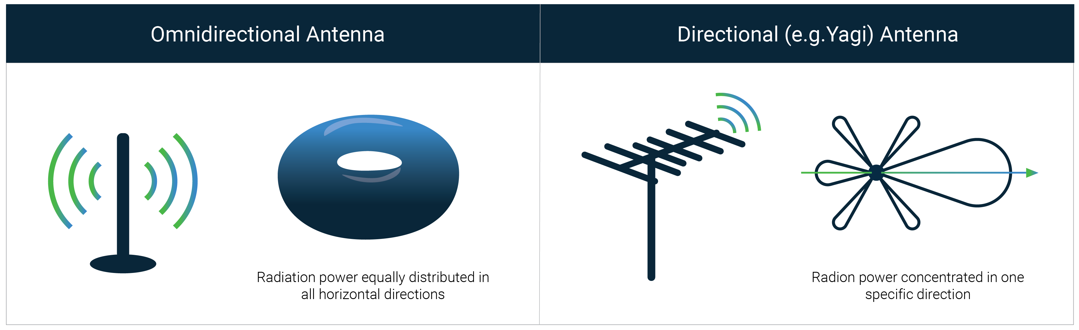
How are radio waves sent from transmitter to receiver
Antenna: An electrical conductor or system of conductor
Transmission: radio frequency electrical energy converted into electromagnetic energy
Reception: the reverse occurs, electromagnetic energy converted into electrical energy
Two-way communication, the same antenna used for transmission and reception
Primarily we have two radiation patterns: omni-directional, directional

Slide 18
How do radio waves propagate from an antenna ?
Different propagation modes for radio waves, important ones are follows:
Ground wave propagation
Sky wave propagation
Line-of-sight propagation

Slide 19
Estimating Communication Range for Wireless Communication
Notes:
++ Over the past few years, I have designed several backscatter and beyond backscatter systems that precisely overcome these critical challenges that have limited the widespread deployment of backscatter on IoT devices.
++ The research vision that I have pursued and would like to pursue as a faculty member is to enable a massive deployment of IoT devices by bridging the energy asymmetry between sensing, computation and communication blocks by designing novel platforms and communication mechanisms. I am going to describe some of my research contributions next.

Slide 20
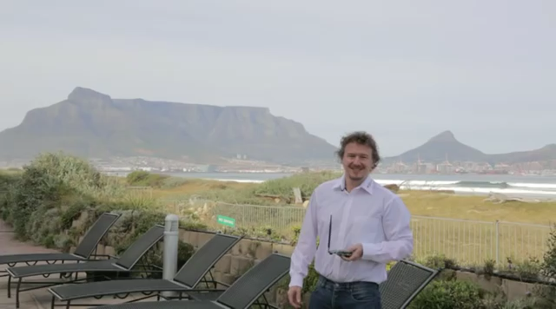
Long range wireless transmissions using IoT devices

Slide 21
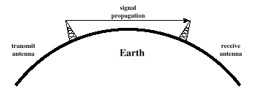
Line-of-sight propagation of radio waves
Transmitting and receiving antennas must be within line of sight
Satellite communication – signal above 30 MHz not reflected by ionosphere
Ground communication – antennas in effective line of site due to refraction

Slide 22
Estimating received signal strength and communication range: Friis propogation model
For line-of-sight path
f_{c} is the center frequency in Hz
c is speed of light
d is the distance between transmitter and receiver
Alpha is the path loss component
G is antenna gain

Slide 23
What is antenna gain? How do we find antenna gain
Power output, in a particular direction, compared to that produced in any direction by a perfect omni-directional antenna (isotropic antenna)‏
Effective area: related to physical size and shape of antenna
Relationship between antenna gain and effective area
G = antenna gain
A_{e} = effective area
f = carrier frequency
c = speed of light 3 X 10⁸ m/s
Lambda = carrier wavelength

Slide 24
Other important parameters and terms
Path Loss in dB
Also simplifies to
Implies a circular disk model for radio propagation.
True in practice?
d

Slide 25
Other important parameters and terms
What if distance is 0 in the Free Space Propagation Model?
Assume a reference distance d₀, chosen to be smaller than any practical distance used (e.g. 1m for indoor, 100m for outdoor)
Units in dBm

Slide 26
Radio propagation is much more complex in real-world, especially when obstacles are present

Slide 27
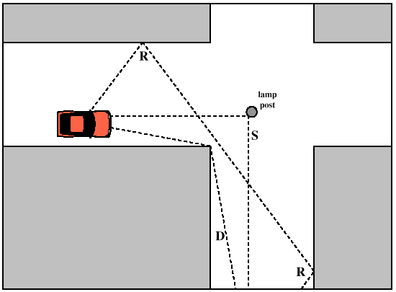
Radio propagation is much more complex in real-world, especially when obstacles are present
Reflection
e.g. earth surface, buildings
Diffraction
Radio wave bends around the obstacle
Scattering
Obstacles smaller than wavelength of wave (e.g. foliage)
Signal is scattered into several weaker signals

Slide 28
Path Loss Exponent
Environment
Path Loss Exponential (α)
Free Space
2
Urban area cellualr radio
2.7 to 3.5
Shadowed urban cellular radio
3 to 5
In building LOS
1.6 to 1.8
Obstructed in building
4 to 6
Obstructed in factory
2 to 3
Rapport, Table 4.2, pp139

Slide 29
Line of Sight Transmission
Free space loss
Signal disperses with distance
Larger loss for higher frequencies
Loss at higher frequencies can be compensate with antenna (gain)‏
Atmospheric Absorption
Water vapour and oxygen absorb radio signals
Water greatest at 22GHz, less below 15GHz
Oxygen greater at 60GHz, less below 30GHz
Rain and fog scatter radio wave

Slide 30
Wireless standards classified on basis of throughput
1 Gbps
802.11ac
4G
802.11n
High Rate UWB
100 Mbps
10 Mbps
1 Mbps
Bluetooth
BLE/802.15.4
100 kbps
LoRA
UWB (802.15.4-2011)
NFC
10 kbps
1GHz
2GHz
3GHz
4GHz
5GHz
6GHz

Slide 31
Nosiy channel: Shannon Capacity
The bandwidth available (B)
The quality of the channel (the level of noise, SNR)
C = B * log₂(1+SNR)
Intuitively, capacity increases with available bandwidth (linear) and increases with SNR (log)

Slide 32
Putting the Equations together
C = B * log₂(1+SNR)
SNR – signal-to-noise ratio
Power is (usually) a constraint
Increase in power can result in higher range/data rate
Increase data rate (C)
Increase throughput by using a larger bandwidth (B)
Transmits at higher frequencies (f)
Range decreases and vice versa
Improve design to increase gain (G)
e.g. OFDM, MIMO etc.

Slide 33
Internet of Things Device Architecture
Notes:
++ Over the past few years, I have designed several backscatter and beyond backscatter systems that precisely overcome these critical challenges that have limited the widespread deployment of backscatter on IoT devices.
++ The research vision that I have pursued and would like to pursue as a faculty member is to enable a massive deployment of IoT devices by bridging the energy asymmetry between sensing, computation and communication blocks by designing novel platforms and communication mechanisms. I am going to describe some of my research contributions next.

Slide 34
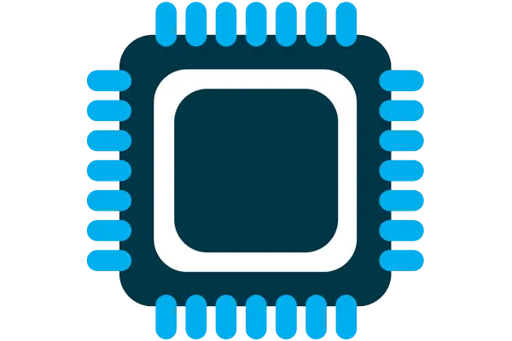
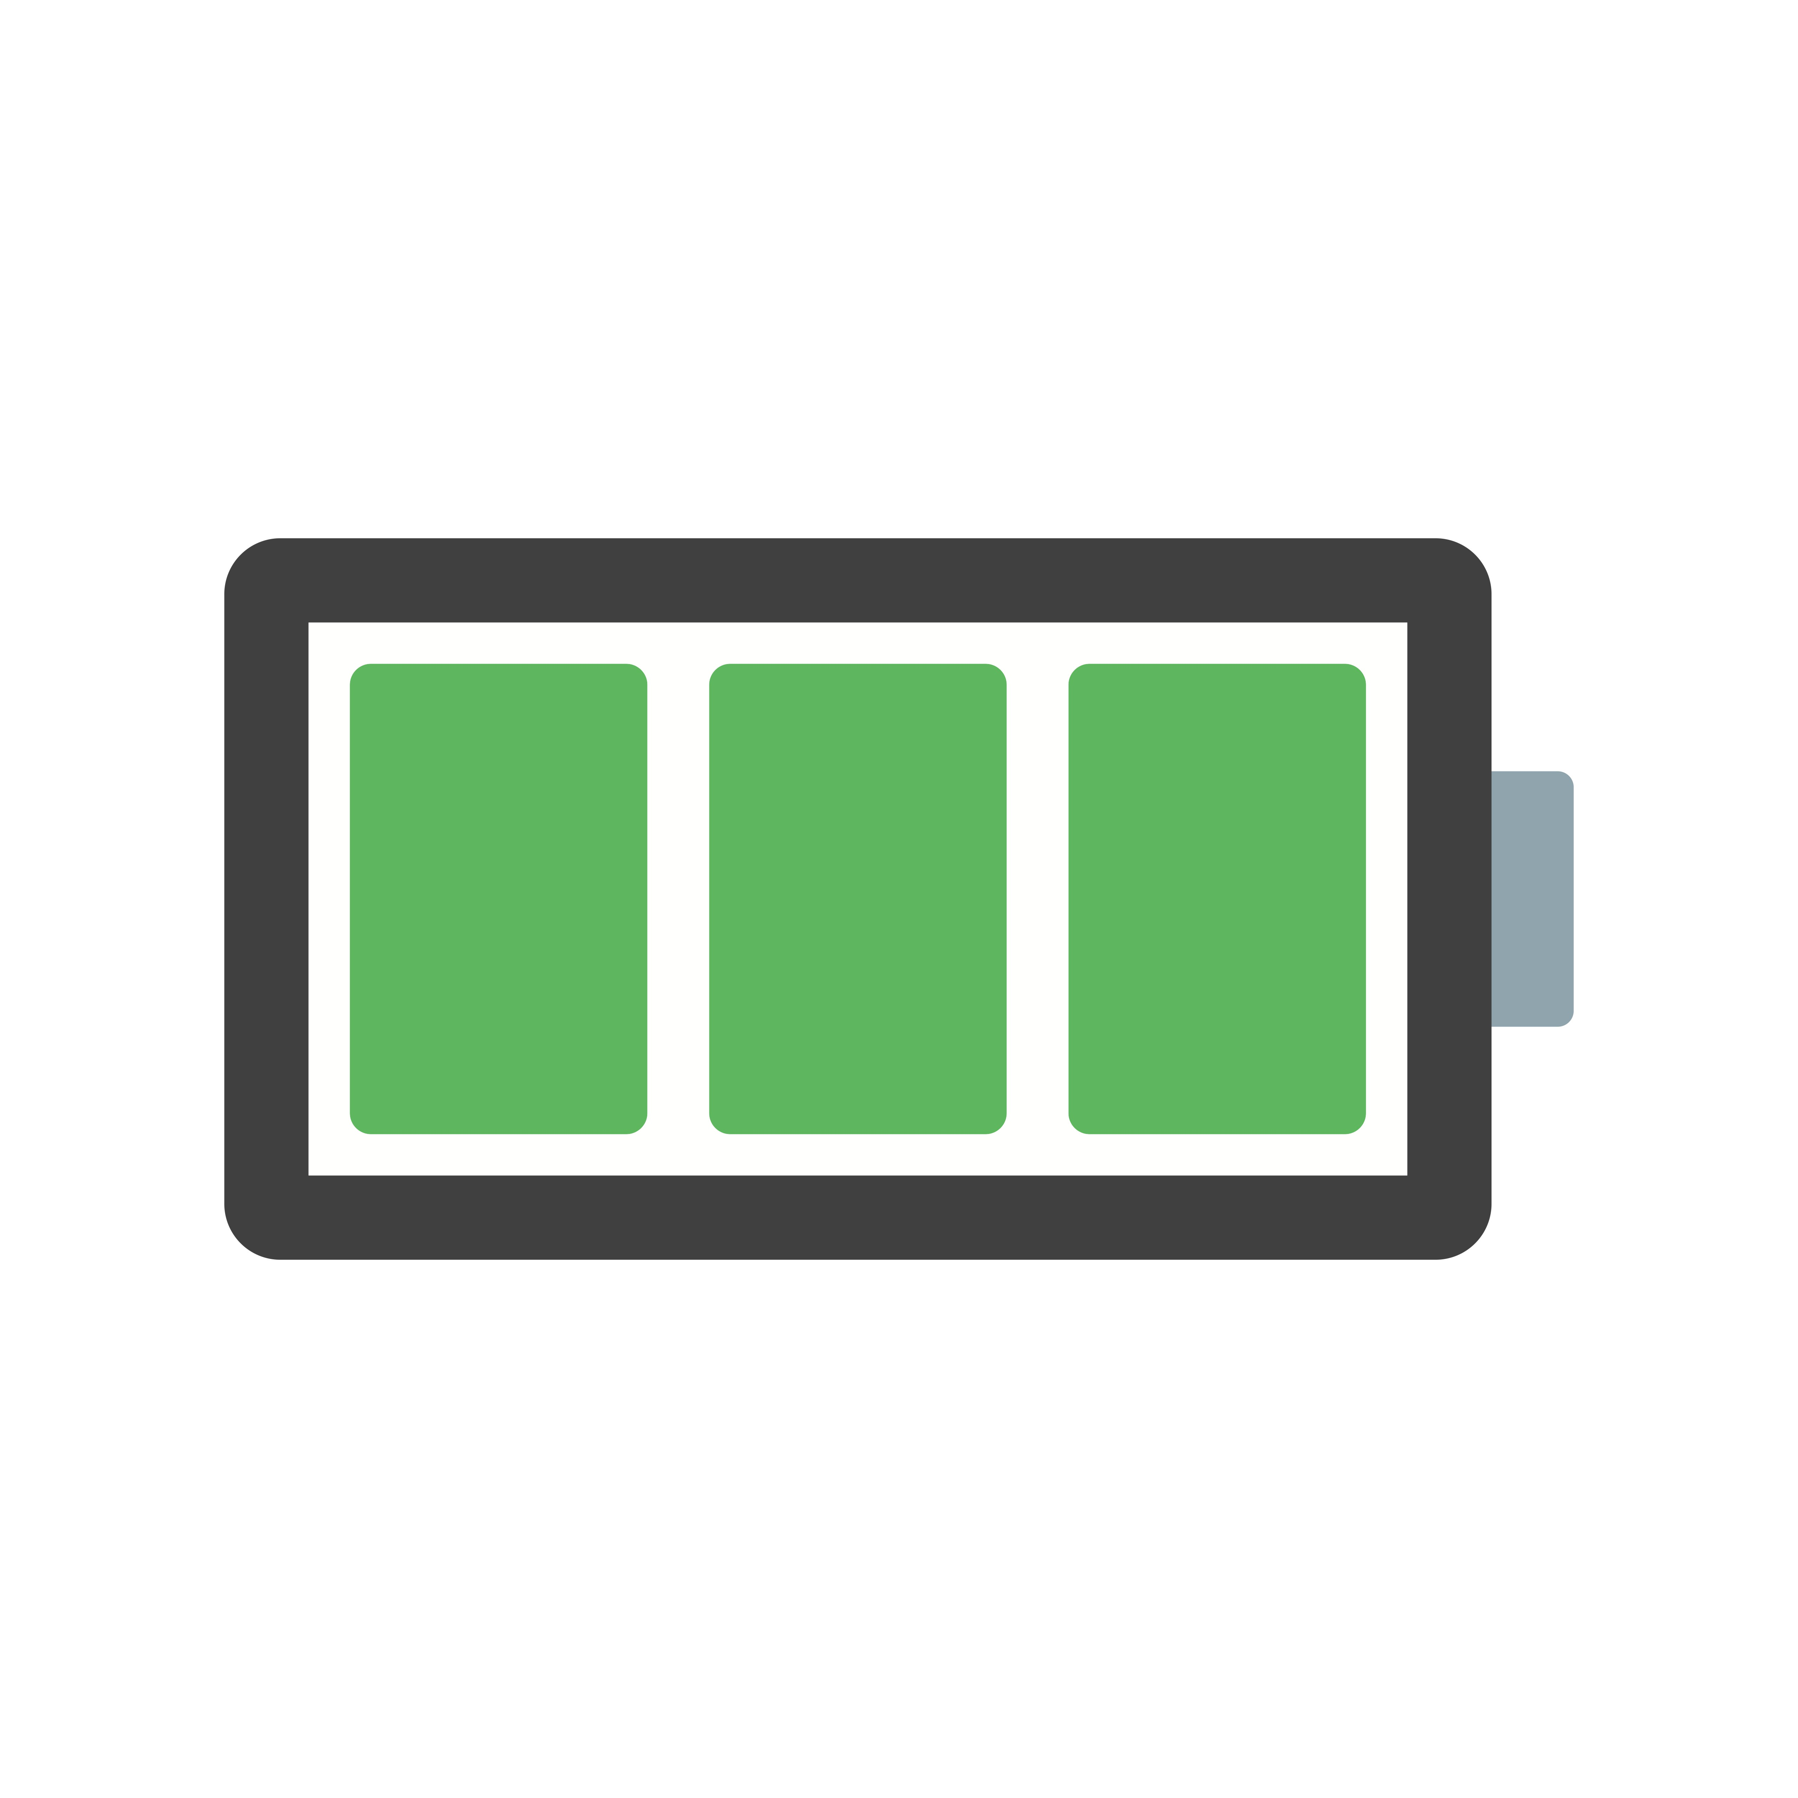


Four major components of IoT device
Computation and Storage
Sensing and Actuation
Power
Wireless Connectivity
Notes:
First, we look at the computational elements, and these consist of a microcontroller or an FPGA. Today, we find that these computational elements consume at least one order of magnitude higher power consumption when compared to the commonly used sensors.
However, we also find that microcontrollers are increasingly becoming energy efficient. We investigate a typical microcontroller that has been used in sensor platforms over the past two decades. We find that energy efficiency has improved by almost two orders of magnitude. Some of the present-generation microcontrollers, such as Ambiq Apollo4 consume just 3 uA/MHz than 330 uA for MSP430 used on platforms such as TelOS B.
If the trend continues, we can expect the microcontrollers to catch up with the sensors and become energy-efficient. This significant improvement is that the digital components are increasing becoming efficient as they follow moore’s law.

Slide 35
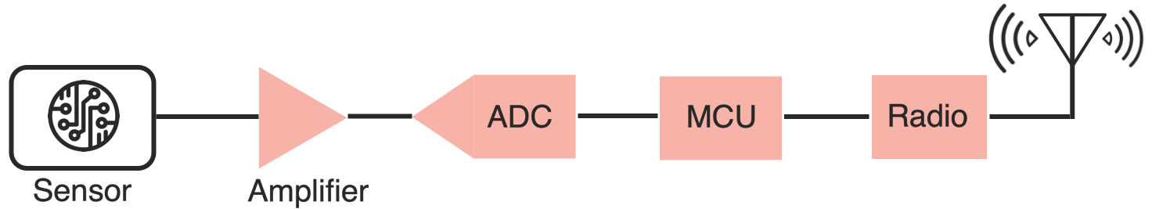
Sensing, Computing and Wireless Communication
IoT device performs (primarily) three tasks: Sensing, Computing and Wireless Communication
Notes:
First, we look at the computational elements, and these consist of a microcontroller or an FPGA. Today, we find that these computational elements consume at least one order of magnitude higher power consumption when compared to the commonly used sensors.
However, we also find that microcontrollers are increasingly becoming energy efficient. We investigate a typical microcontroller that has been used in sensor platforms over the past two decades. We find that energy efficiency has improved by almost two orders of magnitude. Some of the present-generation microcontrollers, such as Ambiq Apollo4 consume just 3 uA/MHz than 330 uA for MSP430 used on platforms such as TelOS B.
If the trend continues, we can expect the microcontrollers to catch up with the sensors and become energy-efficient. This significant improvement is that the digital components are increasing becoming efficient as they follow moore’s law.

Slide 36
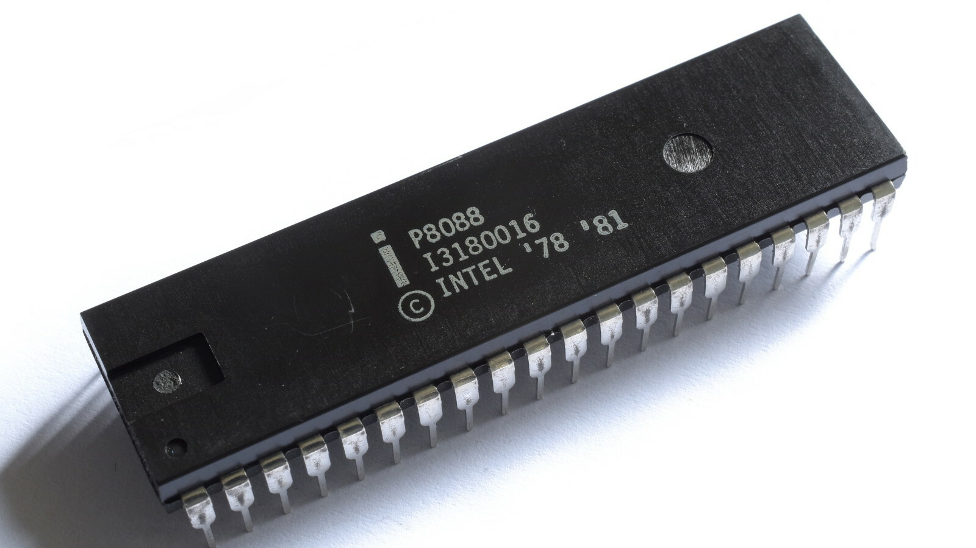
What is at the heart of computers/ IoT devices?
Microprocessor
Usually, they don’t have peripherals or memory
CPU+Pins (No memory, peripherals)
Your computer has a microprocessor
Microcontrollers
We deal with them mostly in embedded and IoT devices
Memory + Peripherals + CPU + Pins
Peripherals: Specialized hardware units within the chip
Notes:
Backscatter communication actually help us overcome this limitation

Slide 37
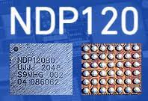
What is at the heart of computers/ IoT devices?
System on chips (SoC)
Microcontroller + Extensive Peripherals
Example: Radios or ML Accelerators
Essentially multiple chips combined
Dedicated accelerator chips
Designed for a very specific purpose like for speech detection
Notes:
Backscatter communication actually help us overcome this limitation

Slide 38
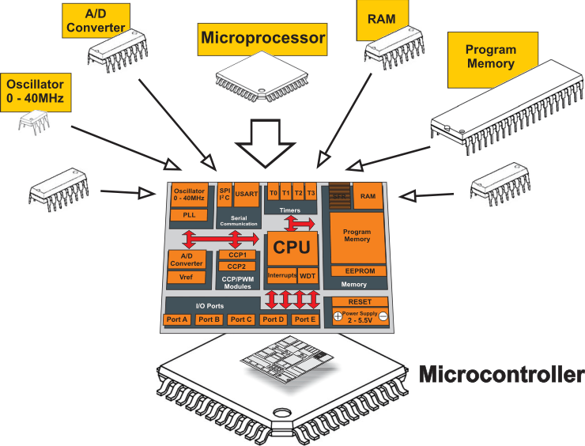
Heart of IoT devices: What is a microcontroller?
A microcontroller (MCU) is a small computer on a single integrated circuit consisting of a relatively simple central processing unit (CPU) combined with peripheral devices such as memories, I/O devices.

Slide 39
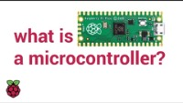
Instructional video (Courtesy: Raspberry PI)

Slide 40
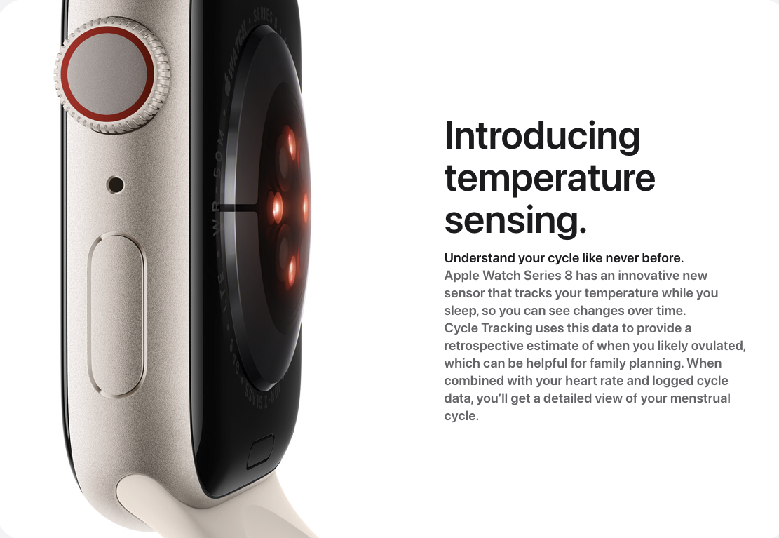
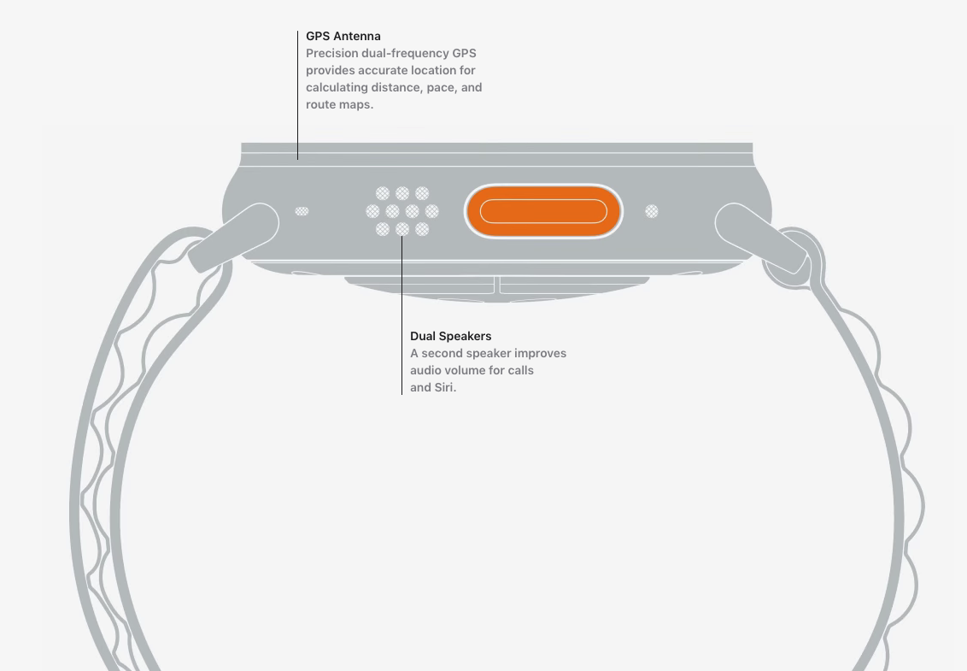
Sensors and actuators are an integral part of most consumer electronic devices
Essential part of almost all consumer electronic devices
They are an Interface of electronic devices with the physical world
Next week: We cover sensors and actuators in greater detail
Courtesy: Apple
Notes:
First, we look at the computational elements, and these consist of a microcontroller or an FPGA. Today, we find that these computational elements consume at least one order of magnitude higher power consumption when compared to the commonly used sensors.
However, we also find that microcontrollers are increasingly becoming energy efficient. We investigate a typical microcontroller that has been used in sensor platforms over the past two decades. We find that energy efficiency has improved by almost two orders of magnitude. Some of the present-generation microcontrollers, such as Ambiq Apollo4 consume just 3 uA/MHz than 330 uA for MSP430 used on platforms such as TelOS B.
If the trend continues, we can expect the microcontrollers to catch up with the sensors and become energy-efficient. This significant improvement is that the digital components are increasing becoming efficient as they follow moore’s law.

Slide 41
This Course (Platforms)
Notes:
++ Over the past few years, I have designed several backscatter and beyond backscatter systems that precisely overcome these critical challenges that have limited the widespread deployment of backscatter on IoT devices.
++ The research vision that I have pursued and would like to pursue as a faculty member is to enable a massive deployment of IoT devices by bridging the energy asymmetry between sensing, computation and communication blocks by designing novel platforms and communication mechanisms. I am going to describe some of my research contributions next.

Slide 42
SensorTag Platform
Notes:
++ Over the past few years, I have designed several backscatter and beyond backscatter systems that precisely overcome these critical challenges that have limited the widespread deployment of backscatter on IoT devices.
++ The research vision that I have pursued and would like to pursue as a faculty member is to enable a massive deployment of IoT devices by bridging the energy asymmetry between sensing, computation and communication blocks by designing novel platforms and communication mechanisms. I am going to describe some of my research contributions next.

Slide 43
Hardware Platform: CC2650 SensorTag
Processor: ARM Cortex M3 32-bit processor, up to 48-MHz clock speed
Memory: 8KB of SRAM for Cache, 20KB of SRAM, 128KB of In-System Programmable Flash
Network: 6LoWPAN, Bluetooth Low energy, RF4CE, ZigBee
10 sensors including support for light, digital microphone, magnetic sensor, humidity, pressure, accelerometer, gyroscope, magnetometer, object temperature, and ambient temperature

Slide 45
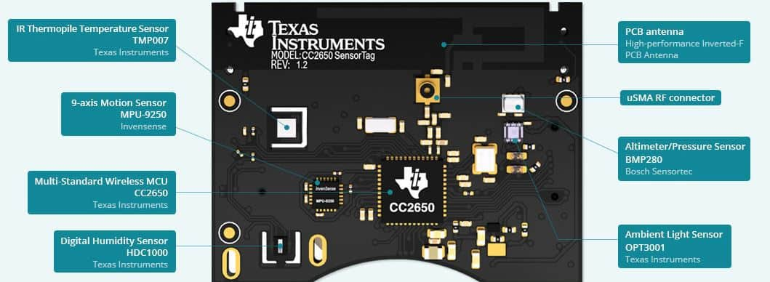

Slide 46
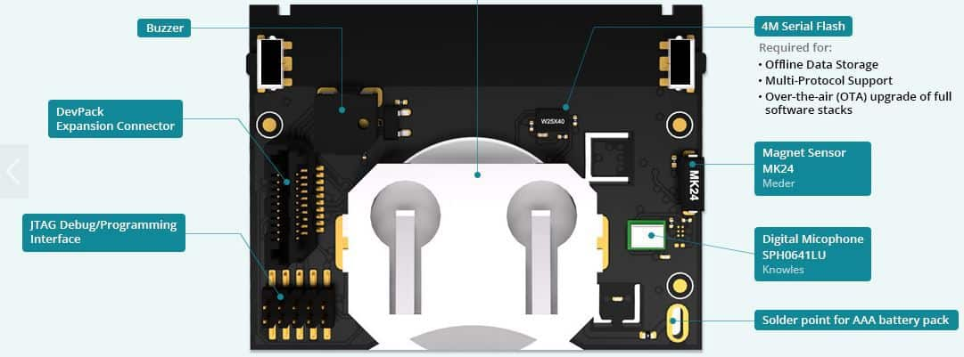

Slide 47
Platforms for Group Projects
Notes:
++ Over the past few years, I have designed several backscatter and beyond backscatter systems that precisely overcome these critical challenges that have limited the widespread deployment of backscatter on IoT devices.
++ The research vision that I have pursued and would like to pursue as a faculty member is to enable a massive deployment of IoT devices by bridging the energy asymmetry between sensing, computation and communication blocks by designing novel platforms and communication mechanisms. I am going to describe some of my research contributions next.

Slide 48
Hardware Platform: CC2650 SensorTag
Processor: ARM Cortex M3 32-bit processor, up to 48-MHz clock speed
Memory: 8KB of SRAM for Cache, 20KB of SRAM, 128KB of In-System Programmable Flash
Network: 6LoWPAN, Bluetooth Low energy, RF4CE, ZigBee
10 sensors including support for light, digital microphone, magnetic sensor, humidity, pressure, accelerometer, gyroscope, magnetometer, object temperature, and ambient temperature

Slide 49
Group projects
Classical group project (uses CC2650 Sensor tags)
Three other group projects
(details TBA) (uses different platform)
Limited number of hardware kits available
For ambitious students
Look out for details over coming weeks!

Slide 50
Hardware Platform: CC1350 MultiProtocol
Processor: ARM Cortex M3 32-bit processor, up to 48-MHz clock speed
Memory: 8KB of SRAM for Cache, 20KB of SRAM, 128KB of In-System Programmable Flash
Wireless connectivity: Bluetooth, ZigBee, sub-GHz (long-range)
Supports: Contiki OS
Great for long-range wireless experimentsMemory: 8KB of SRAM for Cache, 20KB of SRAM, 128KB of In-System Programmable Flash

Slide 51
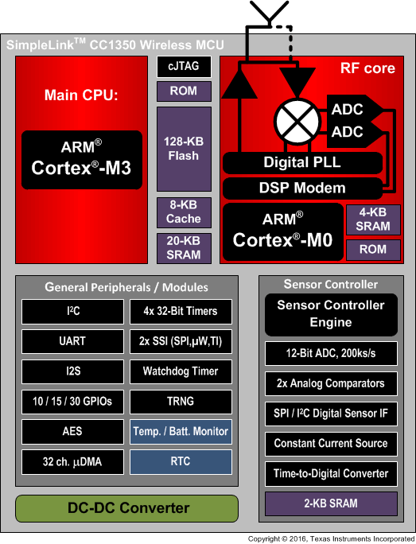
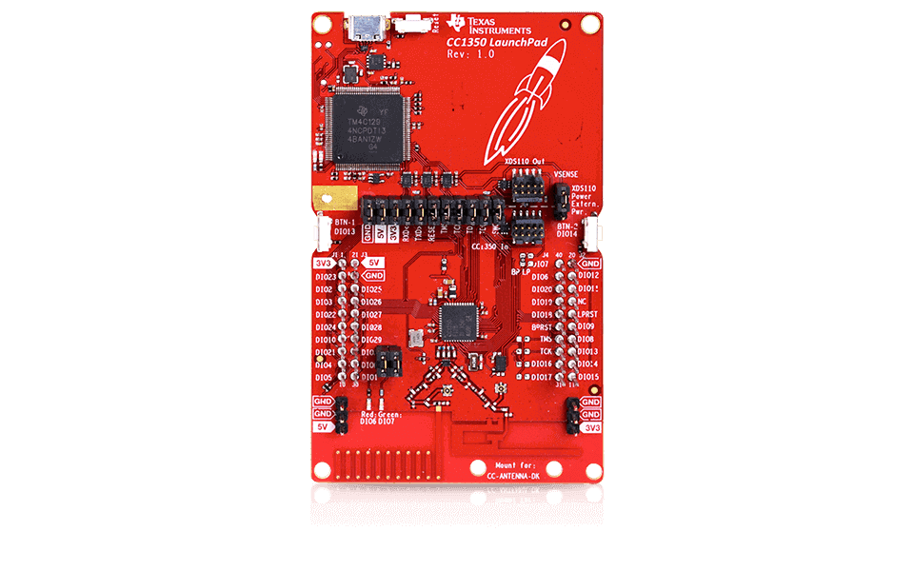
Hardware Platform: CC1350 MultiProtocol

Slide 52
Hardware Platform: Nicla Sense ME
Processor: ARM Cortex M4 32-bit processor, up to 64 MHz clock speed
nRF52832
Memory: 64KB of RAM, 512 KB Flash, 2 MB SPI Flash Storage
Wireless connectivity: Bluetooth 4.2
BHI260AP - Self-learning AI smart sensor with integrated accelerometer and gyroscope; BMP390 - Digital pressure sensor; BMM150 - Geomagnetic sensor; BME688 - Digital low power gas, pressure, temperature & humidity sensor with AI
Can perform onboard machine learning on this platform
We will NOT use Contiki OS with this platform

Slide 53
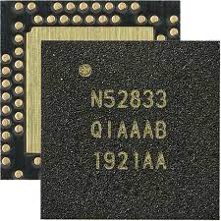
System on chip: nRF52833
32-bit ARM Cortex-M4F microcontroller
64 MHz core, 128 KB RAM, 512 KB Flash
Floating point support
2.4 GHz Radio: Bluetooth Low energy / 802.15.4
Various peripherals
ADC, PWM
I2C, UART, SPI, USB
RNG, 32-bit Timers, Watchdog, Temperature
Up to 42 I/O pins

Slide 54
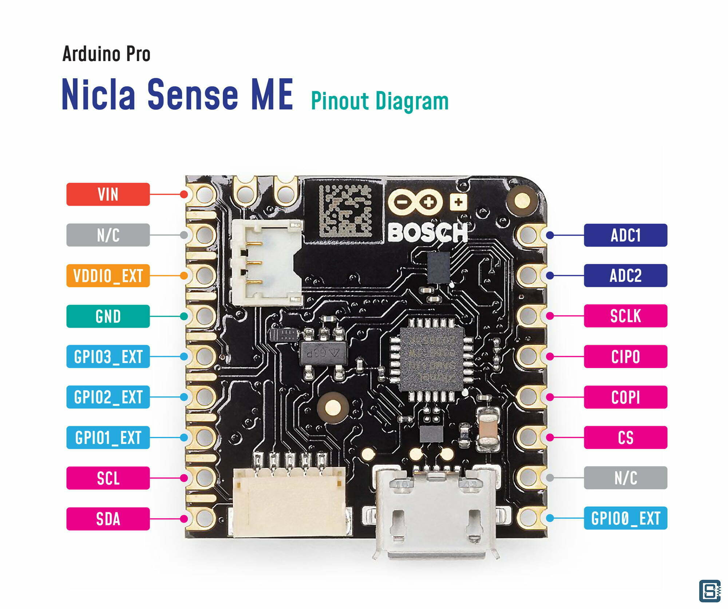
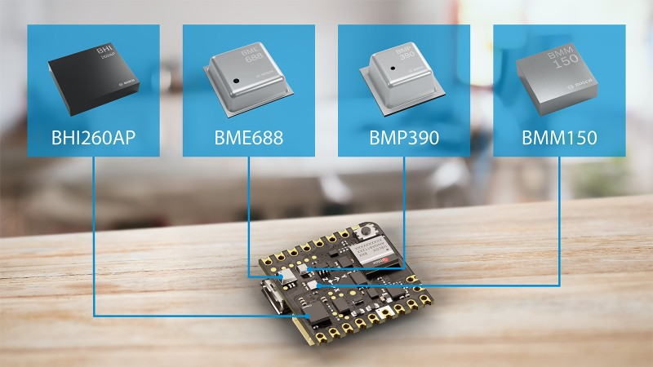
Hardware Platform: Nicla Sense ME

Slide 55
Hardware Platform: Nicla Sense Vision
Processor: ARM Cortex M7 / Dual core
STM32H747AII6 Dual Arm® Cortex® M7/M4 IC
1x Arm® Cortex® M7 core up to 480 MHz
1x Arm® Cortex® M4 core up to 240 MHz
Memory: 1MB of RAM, 2 MB Flash, 16 MB SPI Flash Storage
Wireless connectivity: WiFi and Bluetooth 4.2
2 MP Color Camera 6-Axis IMU (LSM6DSOX) ; Distance / Time Of Flight sensor (VL53L1CBV0FY/1); Microphone (MP34DT05)
Can perform onboard machine learning/vision on this platform
We will NOT use Contiki with this platform

Slide 56
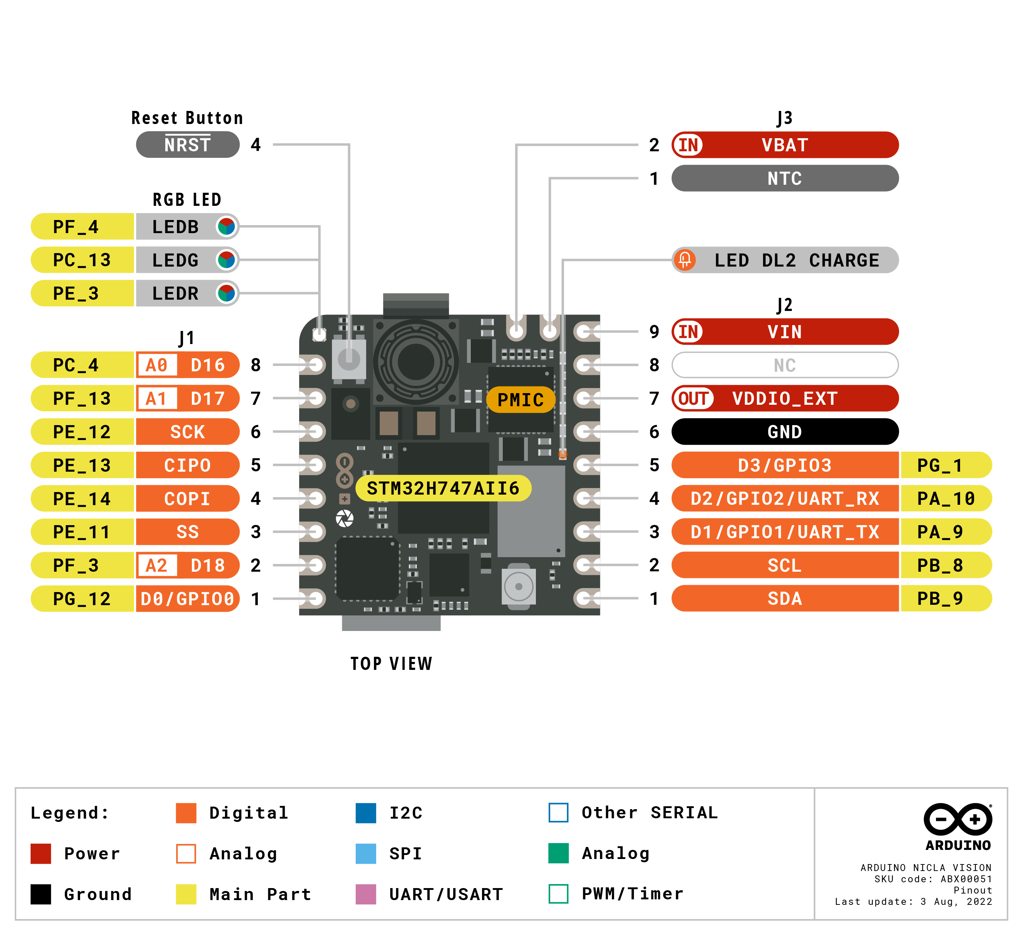
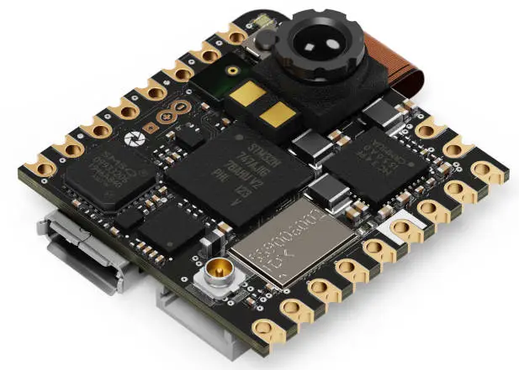
Hardware Platform: Nicla Sense ME

Slide 57
Contiki Operating System
Notes:
++ Over the past few years, I have designed several backscatter and beyond backscatter systems that precisely overcome these critical challenges that have limited the widespread deployment of backscatter on IoT devices.
++ The research vision that I have pursued and would like to pursue as a faculty member is to enable a massive deployment of IoT devices by bridging the energy asymmetry between sensing, computation and communication blocks by designing novel platforms and communication mechanisms. I am going to describe some of my research contributions next.

Slide 58
Operating system for the IoT platforms
Cannot run classic Windows. Even Linux might be too big for many of IoT devices
Several open source operating systems; Ex - TinyOS, RIOT, Zephyr, and Contiki OS
We will use Contiki OS: Individual projects and some group projects
Memory-efficient: 2 kB RAM, 40 kB ROM typically, provides IP support (its uIPv6 stack is IPv6 Ready), supports multi-threading, Protothreads
Runs on many embedded platforms (AVR, MSP430, MSB430, ESB, Apple II, C64, Atari Jaguar, Tandy CoCo, Casio PocketViewer, Sharp Wizard, PC 6001, and many others)
Written in C, under BSD License
Good introduction: course webpage has several articles and interviews

Slide 59
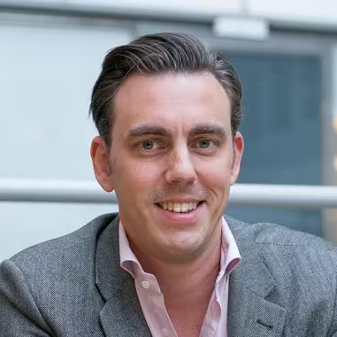


Contiki OS: History and real-world usage
Started in Sweden! Started by – Adam Dunkels at SICS, now Thingsquare
Last year: Awarded 2022 Sensys Test-of-Time Award for Protothreads (2004)
Many developers including in open-source community. Got me interested in this area
Many companies and universities are developing (or has contributed) Contiki OS:
SAP, Cisco, Atmel, NewAE and others
SICS, TU Munich and others

Slide 60
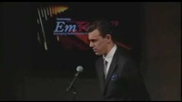
Contiki OS: TR 35 Elevator Pitch!

Slide 61
Contiki OS: Architecture
Modular architecture
Event driven at kernel level, provides optional threading facilities
All OS facilities: senor data handling, communication, device drivers, etc. are provided in the form of services.
Each service has its interface and implementation. Applications using a particular service need to know the service interface

Slide 62
How small can really ContikiOS (with apps) get?
P – size of event queue, S – size of thread stack

Slide 63
Programming Models and Concurrency Support
Sequential (no parallelism)
Poll sensor
Process sensor data
Poll Radio
Process radio packet
Event-driven
Memory
Radio
Sensor
CPU
Multi-threaded
Handle sensor process
Handle radio process

Slide 64
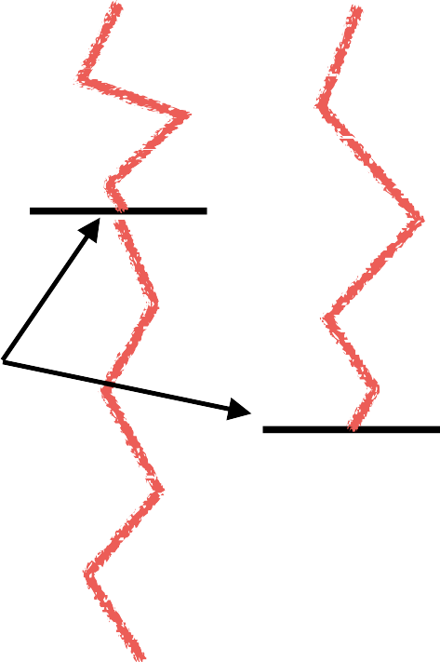

Programming Models and Concurrency Support
Multi-threaded model:
Threads blocked, waiting for events
Kernel unblocks thread when event occurs
Thread runs until next blocking statement
(or preempted)
Each thread requires own stack
− RAM usage not negligible: For a node with 2KB,
100 bytes is ~5%!
Thread 1
Thread 2
Kernel

Slide 65
Programming Models and Concurrency Support
Event-driven model:
Code only runs within event handlers
On an event occurrence: kernel invokes handler code
Event handler runs till completion: explicit return;
Event Handler 1
Event Handler 2
Kernel
Event Handler 3

Slide 66
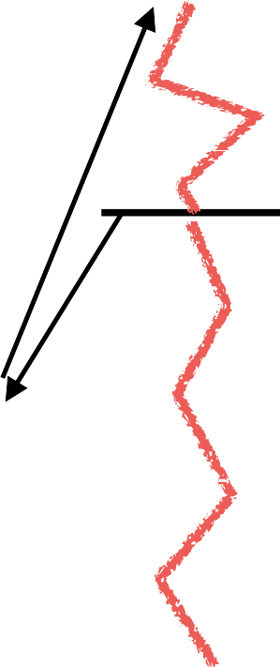
Contiki’s Concurrency Support
Contiki’s kernel is event-based
most programs run directly on top of the kernel
Thread 1
Thread 2
Multi-threading implemented as a library
Threads only used if explicitly needed (e.g., long computations)
Preemption possible
Event Handler 1
Event Handler 2
Kernel
Event Handler 3

Slide 67
Memory Management
Supports dynamic memory management. Memory blocks are allocated/allocated by the memb_alloc()/memb_free function
Supports dynamic linking of the programs
Uses a Managed Memory Allocator to keep the allocated memory free from fragmentation. If a program uses the memory allocator module, it cannot be sure that allocated memory stays in place
Does not provide any memory protection mechanism between different applications

Slide 68
Communication Protocol Support
Provides an implementation of TCP/IP protocol stack for small 8 bit micro-controllers (uIP). Written in C and it has the minimum set of features needed for a full TCP/IP stack.
Provides RIME, a lightweight layered protocol stack for network-based communication. Rime provides single hop unicast, single hop broadcast, and multi-hop communication support. Applications are allowed to implement protocols that are not present in the Rime stack.
Does not support multicast.
Provide IPv6 routing protocol for low power and lossy networks exists an implementation of RPL called ContikiRPL

Slide 69
Contiki Documentation
Contiki’s homepage:
http://www.contiki-os.org/
Contiki’s Wiki:
http://github.com/contiki-os/contiki/wiki
Doxygen documentation:
http://contiki.sourceforge.net/docs/

Slide 70
Example: generic template
#include “contiki.h”
PROCESS(my_example_process, “my example process”); AUTOSTART_PROCESSES(&my_example_process); PROCESS_THREAD(my_example_process, ev, data)
{
PROCESS_BEGIN();
// initialize statements come here
// while(1) {
// perform tasks here
// PROCESS_WAIT_EVENT();
} PROCESS_END();
}

Slide 71
Quick start example: hello_world.c
#include “contiki.h”
#include <stdio.h>
PROCESS(hello_world_process, “hello world”); AUTOSTART_PROCESSES(&hello_world_process); PROCESS_THREAD(hello_world_process, ev, data)
{
PROCESS_BEGIN();
// initialize statements come here
printf(“Hello world!\n\r”);
while(1) {
// perform tasks here
// PROCESS_WAIT_EVENT();
}
PROCESS_END();

Slide 72
Conclusion and next week
Calculating range for communication; Free space path loss, Friis
Overview of IoT devices, microcontroller and platforms
Platforms for group project
Introduction to Contiki operating system
Next week: Continue to look into IoT device, sensors and actuators, and energy aspect of these devices
Notes:
++ We may all have heard of the term Internet of Things. So how are these wireless embedded systems related to the Internet of Things: Today, IoT includes a broad class of devices, including powerful platforms such as smartphones. However, it also includes more resource-constrained devices and what we call Wireless Embedded Systems, and in fact, I consider it to be one of the essential parts of the IoT ecosystem.
++ These are platforms equipped with a radio transceiver, sensor, microcontroller, and some form of energy storage. These platforms also often form a network, and sensor network as it is called has been an active area of research for the past two decades.
++ The research community has also developed wireless embedded platforms which we may know about, and these include: CMUCAM, which is an image sensor platform developed at Carnegie Mellon University, or Permamote is long life sensor platform from the lab I am associated with at UC Berkeley or Lorea which is a long-range backscatter platform that I had developed as part of my doctoral dissertation at Uppsala University. All of these are an example of Wireless Embedded Systems.

Slide 73
Programming Assignments (Individual)
Programming
Week 2 (this week): Collect device (SensorTag + debugging board)
Week 3/4: Assignment 1 (3%): installation, “Hello World” program (Released Saturday)
Week 5: Assignment 2 (7%): Timer and sensors (Release: TBA)
Written Assignment
Week 11 (10%): Written Assignment
Ms. Lim Chew Eng (limce limce@comp.nus.edu.sg)
Venue: Datacom Lab (COM1#B1-02)
Issue device to students on:
Date: 19 Jan (Thurs)
Time : 2pm to 4.30pm

Slide 74
CS 4222 – Wireless Networking
Ambuj Varshney
ambujv@nus.edu.sg
http://ambuj.se
Notes:
Good morning/afternoon everyone. Thank you for inviting me for giving this talk.
In this talk, I will describe my effort to design ubiquitous Internet of Things systems.
In the end of the talk: I will cover some of the future research directions that I would like to address as a faculty member.

Slide 75
Break! (10 minutes)
Notes:
++ Over the past few years, I have designed several backscatter and beyond backscatter systems that precisely overcome these critical challenges that have limited the widespread deployment of backscatter on IoT devices.
++ The research vision that I have pursued and would like to pursue as a faculty member is to enable a massive deployment of IoT devices by bridging the energy asymmetry between sensing, computation and communication blocks by designing novel platforms and communication mechanisms. I am going to describe some of my research contributions next.

